Slide 1
Foam Filtration
Kristin Chu
Marlana Hinkley
Ethan Keller
Valerie Pietsch
Notes:
Kristin

Slide 2
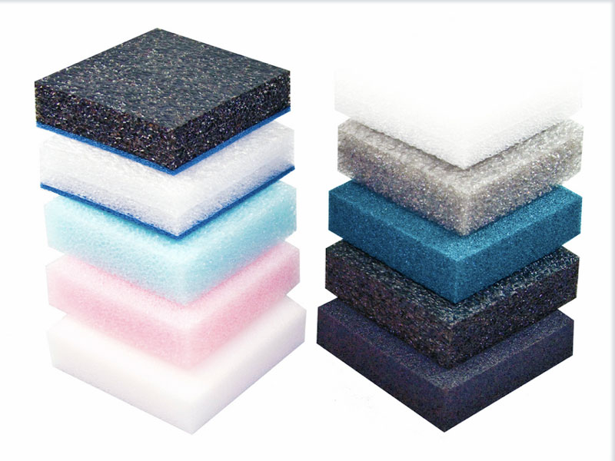
Why Foam?
Less water wasted
Less space needed
Less expensive
This would be most
beneficial for:
Medium sized villages
Emergency situations
Temporary situations
Notes:
Kristin
1 min

Slide 3
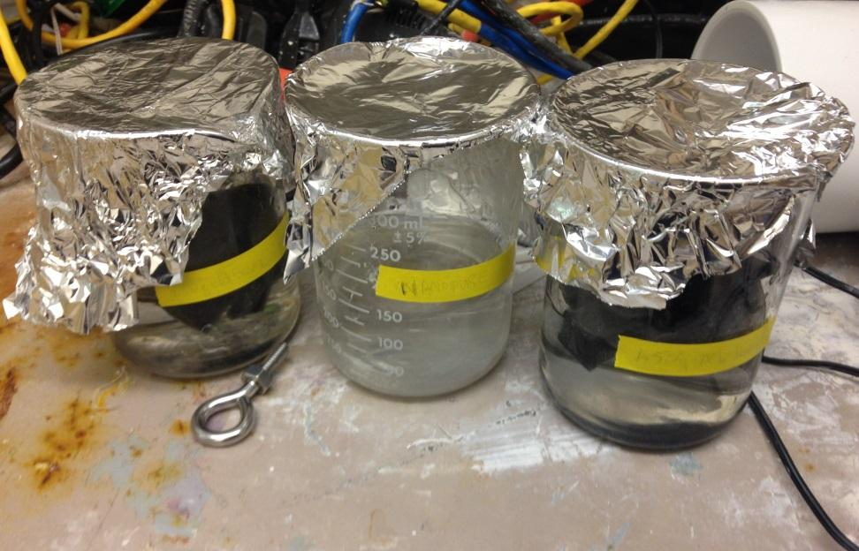
Is Foam Safe?
Ether- and ester-based reticulated polyurethane foam
Conducted an initial leaching test using mass spectrometer, ester-based foam→ LEACHES
Follow-up on hold
Notes:
Kristin
Discuss characteristics of foam… Pore size.. what is it? (samples) and what is reticulated? (open-cell structure)... do we ever discuss how foam works?
2 min.

Slide 4
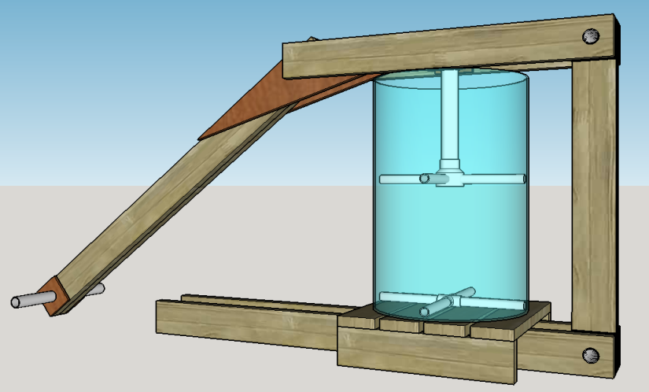
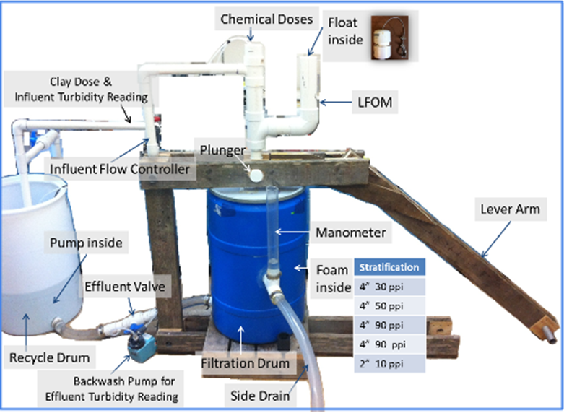
Large Filter
How does it work?
Demonstrated Capability:
Treats up to 1000 NTU down to <2 NTU ⇒ pC* = 2.7
Backwash cleans 70%
1L/S
Issues:
Heavy lever arm
Current foam lifter broke
Notes:
Ethan

Slide 5
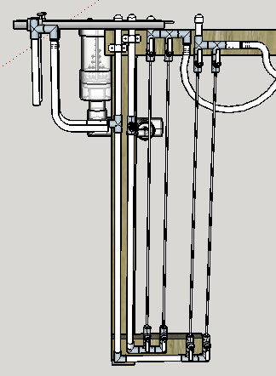
Proposed CDC System
Smaller, Compact, Robust
Place float into LFOM to eliminate need for entrance tank
Run Major Headloss Elements (MHE) vertically to reduce overall size
Notes:
Ethan

Slide 6
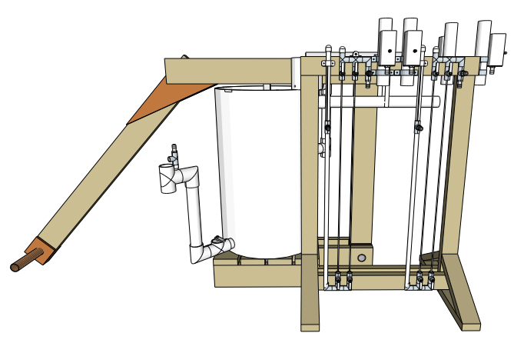
Proposed CDC System
Notes:
Ethan

Slide 7
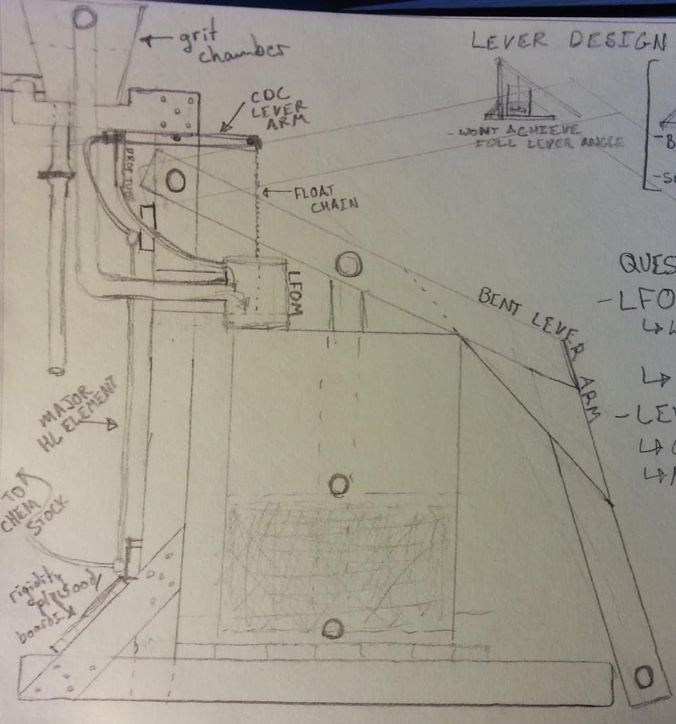
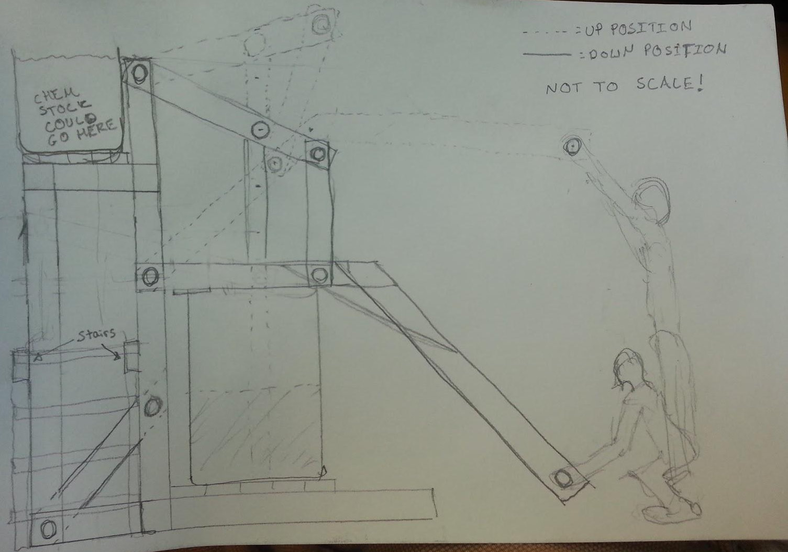
Rigid Vertical Lever Arm?
Notes:
Ethan
Need lever arm to be more stable

Slide 8
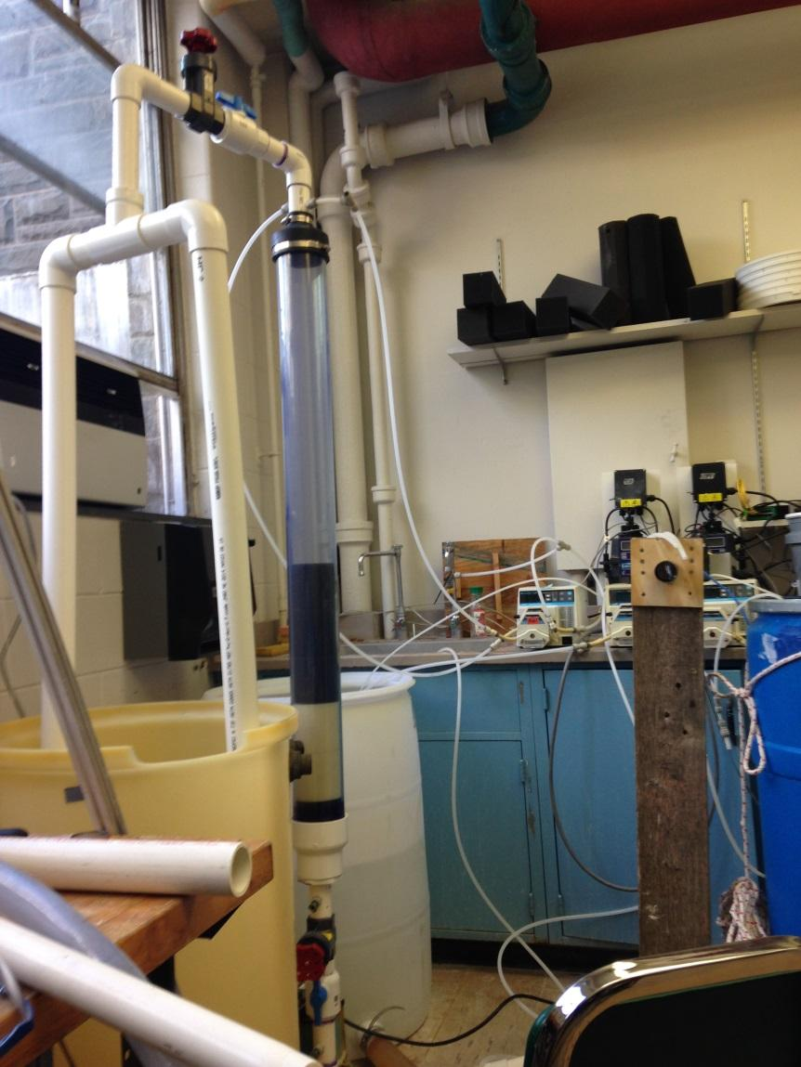
Small Filter: Why?
Objective: collect data on efficiency of backwash system
Function: replicates large scale filter
Benefits: easy to operate
Notes:
Kristin

Slide 9
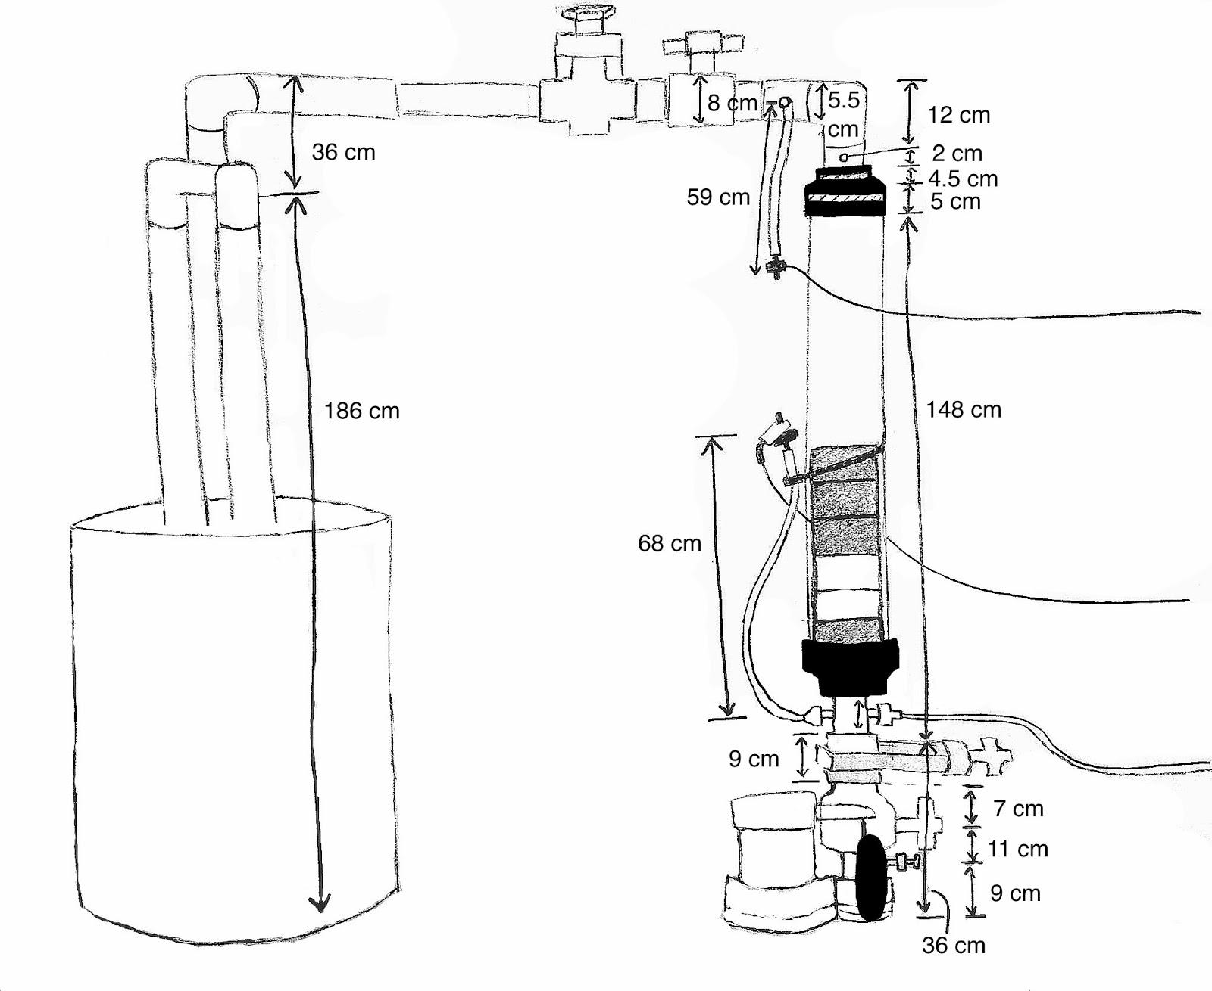
Small Filter: How?
1.5 L/s backwash simulates lever arm
Notes:
Marlana

Slide 10
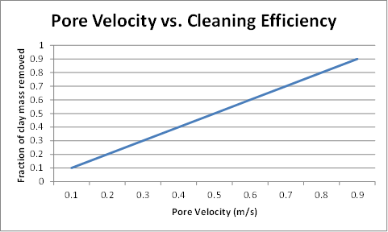

Pore Velocity vs. Cleaning Efficiency
Objective: Empirical relationship between backwash pore velocity and filter cleaning efficiency
Each pore velocity will remove a certain mass percentage of the clay
Notes:
Marlana

Slide 11
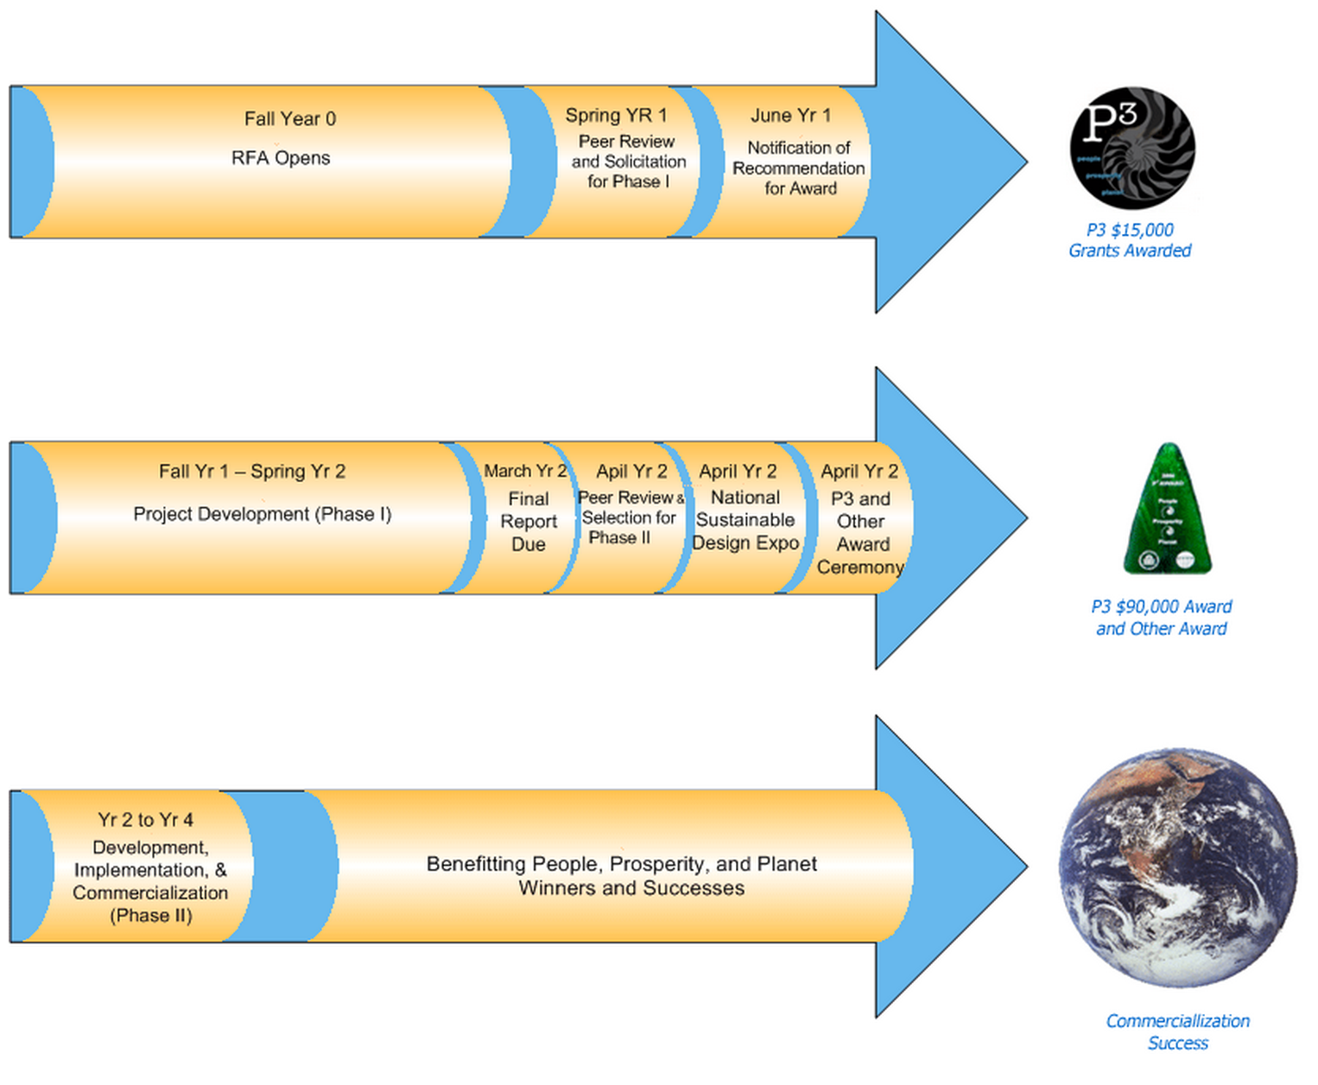
EPA P3 Award Phase 2
We’re going to D.C. to win $75,000!
Notes:
Val
EPA key contacts, Application for Federal Assistance, & Project Narrative form

Slide 12
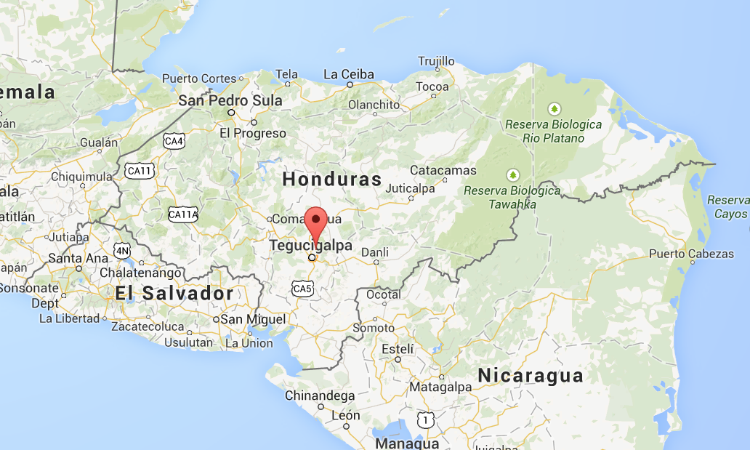
January Trip Objectives
Finishing construction of and testing 2 foam filters in El Carpintero
Presenting the technology to the Swiss Cooperation
Notes:
Val

Slide 13
What’s Next
Continue researching what could be leaching from foam
Run tests and collect data on the small filter
Fabricate & implement LFOM & CDC designs on large filter
EPA Phase 2 Project Proposal
Notes:
Val

Slide 14

Questions???

Slide 15
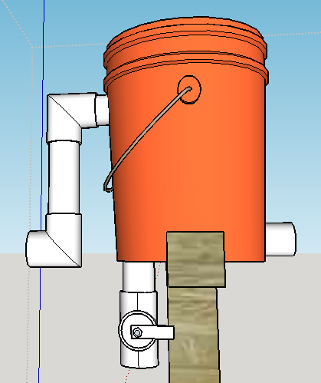
Grit Chamber and Entrance Tank?
Both determined not necessary:
Too much money
Break the rules!!
Top layer of Foam acts as Grit Chamber
Notes:
Ethan-1 min

